Slide 1
Baseball by the Numbers
a Brownbag Presentation
by John Aleshunas
27 March 2008

Slide 2
Baseball is like a church, many attend but few understand.
Wes Westrum

Slide 3
Outline
Data use example
Sabermetrics
Data sources
Tools
Resources
Further analysis examples

Slide 4
Geek Warning
This presentation is for folks who want to get data, crunch data and analyze data.
If you want to view the highlights, please watch SportsCenter on ESPN.

Slide 5
Relax
The presentation PowerPoint slides and all of the presentation references can be found at:
http://mercury.webster.edu/aleshunas

Slide 6
Batters vs. Pitchers
It’s been going on in baseball for 100 years. When pitchers make quality pitches, batters do not make good contact.
Tony La Russa

Slide 7
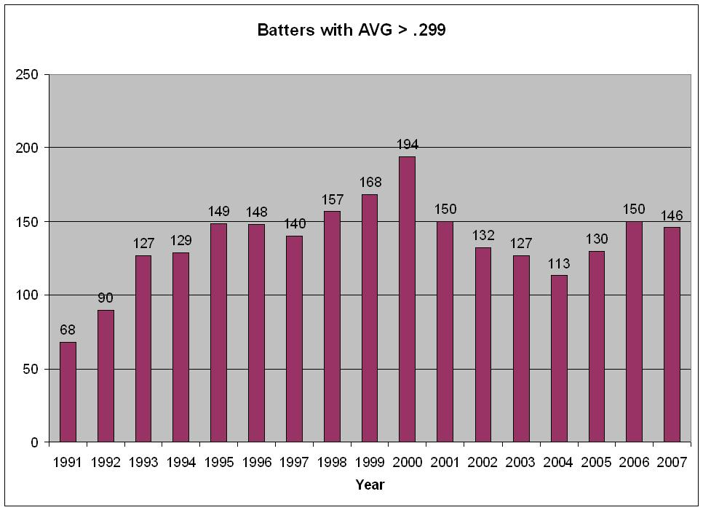
Batter Analysis

Slide 8
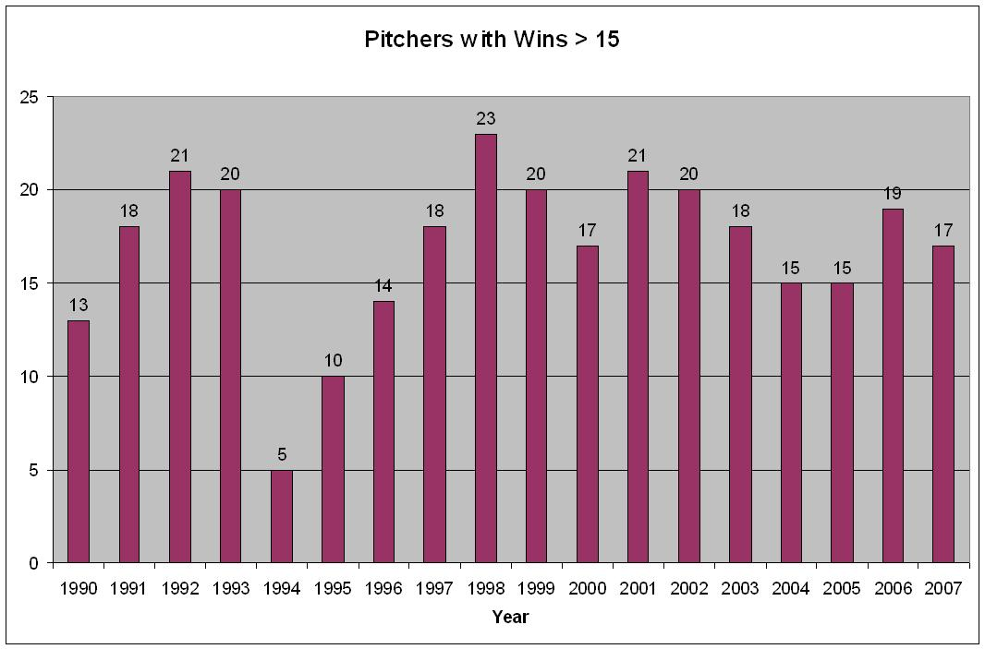
Pitcher Analysis

Slide 9
Batters vs. Pitchers

Slide 10
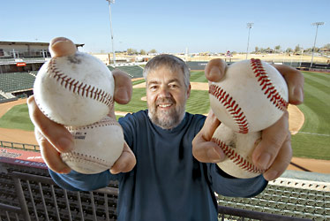
Bill James
George William “Bill” James (born October 5, 1949, in Holton, Kansas) is a baseball writer, historian, and statistician whose work has been widely influential. Since 1977, James has written more than two dozen books devoted to baseball history and statistics. His approach, which he termed sabermetrics in reference to the Society for American Baseball Research (SABR), scientifically analyzes and studies baseball, often through the use of statistical data, in an attempt to determine why teams win and lose. In 2006, Time magazine named him in the Time 100 as one of the most influential people in the world.

Slide 11
SABR
Society for American Baseball Research
The Society for American Baseball Research (SABR) was established in Cooperstown, New York in August, 1971. Their mission is to foster the study of baseball past and present, and to provide an outlet for educational, historical and research information about the game.
http://www.sabr.org/

Slide 12
Data Sources (pay)
The Baseball Cube
Baseball Info Solutions
Baseball Prospectus
Baseball Reference
All of these sources offer good service, for a fee

Slide 13
Data sources (free)
Society for American Baseball Research (SABR)
Lahman database
Retrosheet
Baseball Index
The Official MLB Website
These are good low-cost data sources

Slide 14
Lahman Database
Compiled annual data for batters, fielders, pitchers, managers and teams
Covers all major league baseball from 1870 to present (current to 2007)
MS Access DB - http://www.baseball1.com/
MySQL DB - http://www.baseball-databank.org/

Slide 15
Retrosheet Data
Retrosheet is a non-profit corporation, incorporated in the State of Delaware in 1994.
Retrosheet's work has three distinct aspects.
First is the collection of the game accounts, which have been obtained from several sources.
The second activity is the translation of these accounts to a unified, modern system which is essential since there are an extraordinary variety of scoring systems which have been used.
The final activity is the entry of the translated accounts into the computer.
The first meeting of Retrosheet, Inc. was held in Arlington, TX on June 17, 1994.

Slide 16
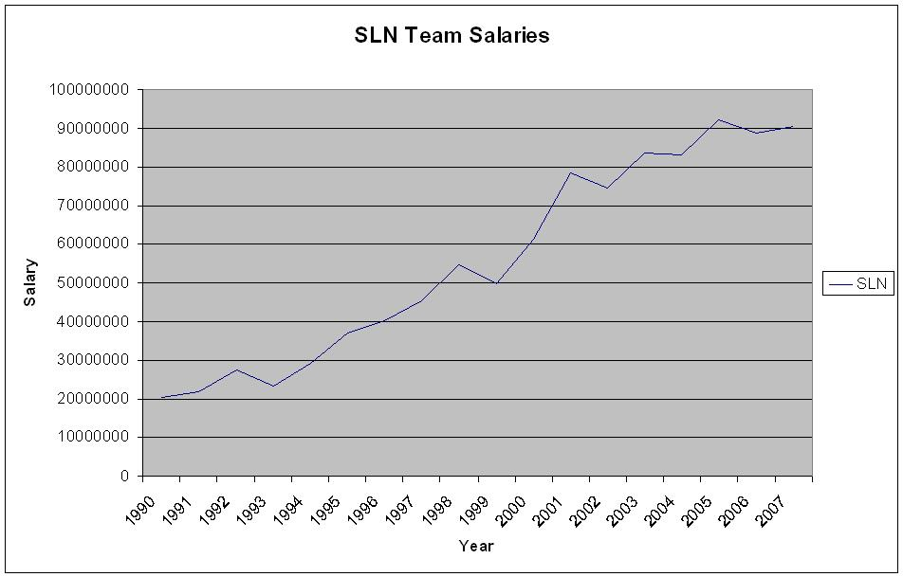
Salary Analysis

Slide 17
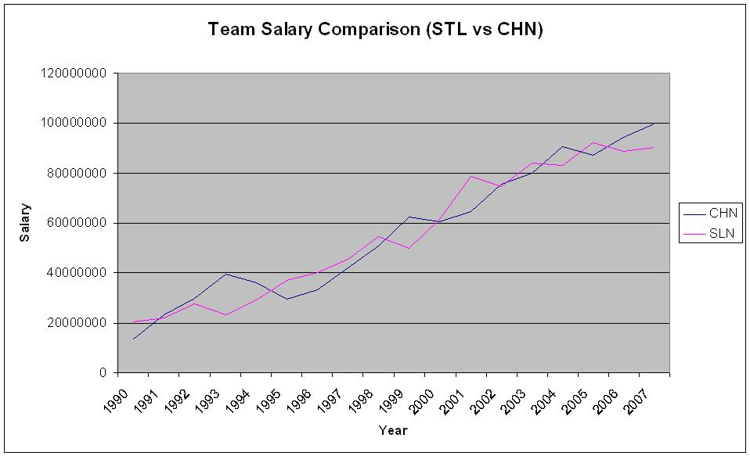
Salary Analysis (STL vs. CHC)

Slide 18
Data Manipulation & Analysis Tools (pay)
Microsoft Office
Excel (spreadsheet)
Access (database)
SPSS, SAS (statistical analysis software)
Oracle (database) *

Slide 19
Microsoft Excel & Access
Familiar
Established applications
Reference materials
User generated files
Cost: $500 (retail – MS Office Professional)

Slide 20
SPSS
GUI based statistical software
Industry leader
http://www.spss.com/
Cost: $639 (Base – Higher Ed, $1699 Commercial)

Slide 21
Data Manipulation & Analysis Tools (free)
Open Office
Calc (spreadsheet)
Base (database)
R, Octave, Sage (statistical and mathematical analysis)
MySQL (database)
Perl (programming language)

Slide 22
Open Office Calc & Base
OpenOffice.org is a multiplatform and multilingual office suite and an open-source project
Compatible with all other major office suites
The product is free to download, use, and distribute
http://www.openoffice.org/

Slide 23
R, Octave & Sage
R is a free software environment for statistical computing and graphics
GNU Octave is a high-level language, primarily intended for numerical computations
It is mostly compatible with Matlab
It is also freely redistributable software
SAGE is a viable free open source alternative to Magma, Maple, Mathematica, and Matlab

Slide 24
MySQL Database
The world's most popular open source database (free for personal use)
http://www.mysql.com/
Learning MySQL by Seyed Tahaghoghi & Hugh Williams

Slide 25
PERL Language
Programming PERL by Larry Wall, Tom Christiansen & Jon Orwant

Slide 26
Manager Career Winning
Which MLB manager has the most career wins?
We’ll use the Lahman database on MySQL

Slide 27
Salary Analysis - revisited
Let’s redo the team salary analysis to show the steps in developing the chart
We’ll add Houston to the mix, just to add additional interest

Slide 28
Retrosheet Download and Processing
Let’s download a file from Retrosheet and process it.
Download
Bevent processing
Opening in a spreadsheet
Loading into MySQL

Slide 29
Double Play Analysis
Which MLB batter hit into the most double plays in 2007?
We’ll use Retrosheet data, again on MySQL

Slide 30
Intentional Walk Analysis
The goal, in baseball, is to score more runs than your opponent
You score runs by putting runners on base
Therefore it seems counter-intuitive for the defense to put a runner on base
Reasons for an intentional walk
Avoid a dangerous hitter
Set up a double play situation

Slide 31
Intentional Walk Analysis
In 2006 NL play, 37.6% of IWs were followed by a run scored
An average NL batter had a .272 BA (>149 AB)
The best batter had a .344 BA
A hit resulted in a run 53.2%
Advantage = P(hit) * P(run)
Average hitter = (.272)*(.532) = 0.145
Best hitter = (.344)*(.532) = .183
Intentional walk = (1.000)*(.376) = 0.376

Slide 32
Further Reading
Baseball Hacks by Joseph Alder

Slide 33
Summary
Data use example
Sabermetrics
Data sources
Tools
Resources
Further analysis examples

Slide 34
You know how to pitch God?
Hard stuff inside, then down and away, and if you get it there you’ll get Him out. Even though He’ll know it’s coming. Or at least they say He knows.
Jim Lefebvre

Slide 35
References
Will, George (1990), Men at Work the Craft of Baseball, New York, Macmillan Publishing Company
Bill James Article, http://en.wikipedia.org/wiki/Bill_James
My Web Site, http://mercury.webster.edu/aleshunas

